Slide 1
Crestone Seismic Software Toolkit 2013 www.crestoneseismic.com

Slide 2
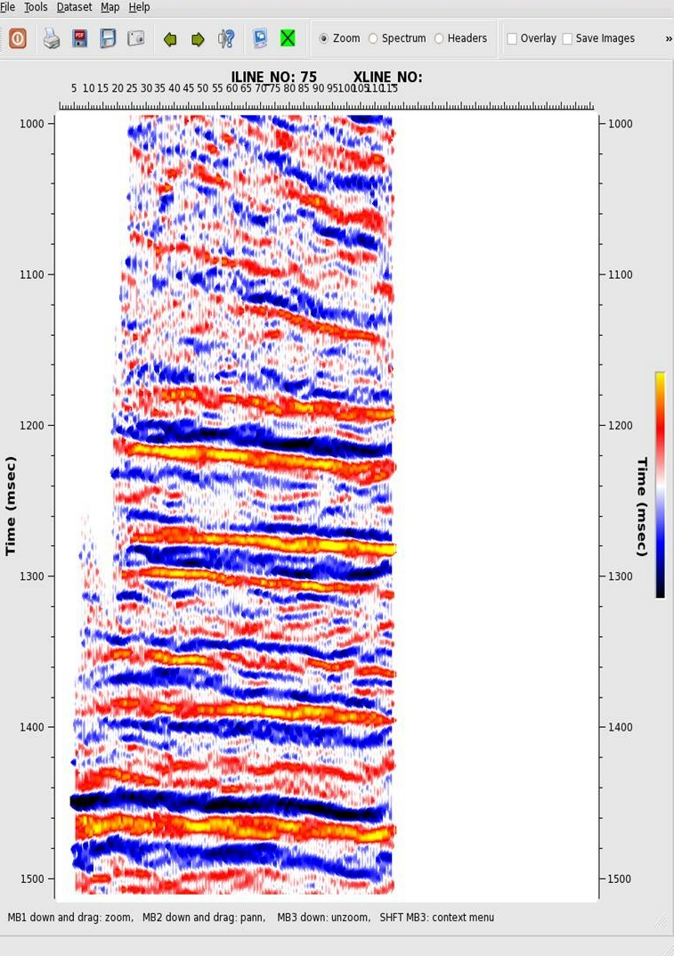
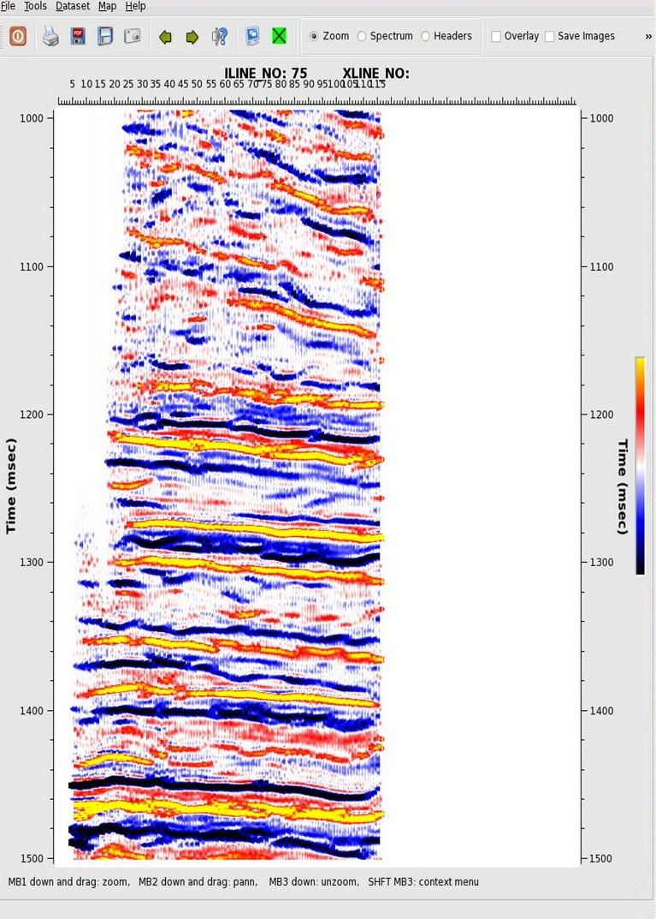
3D High Frequency Enhancement

Slide 3
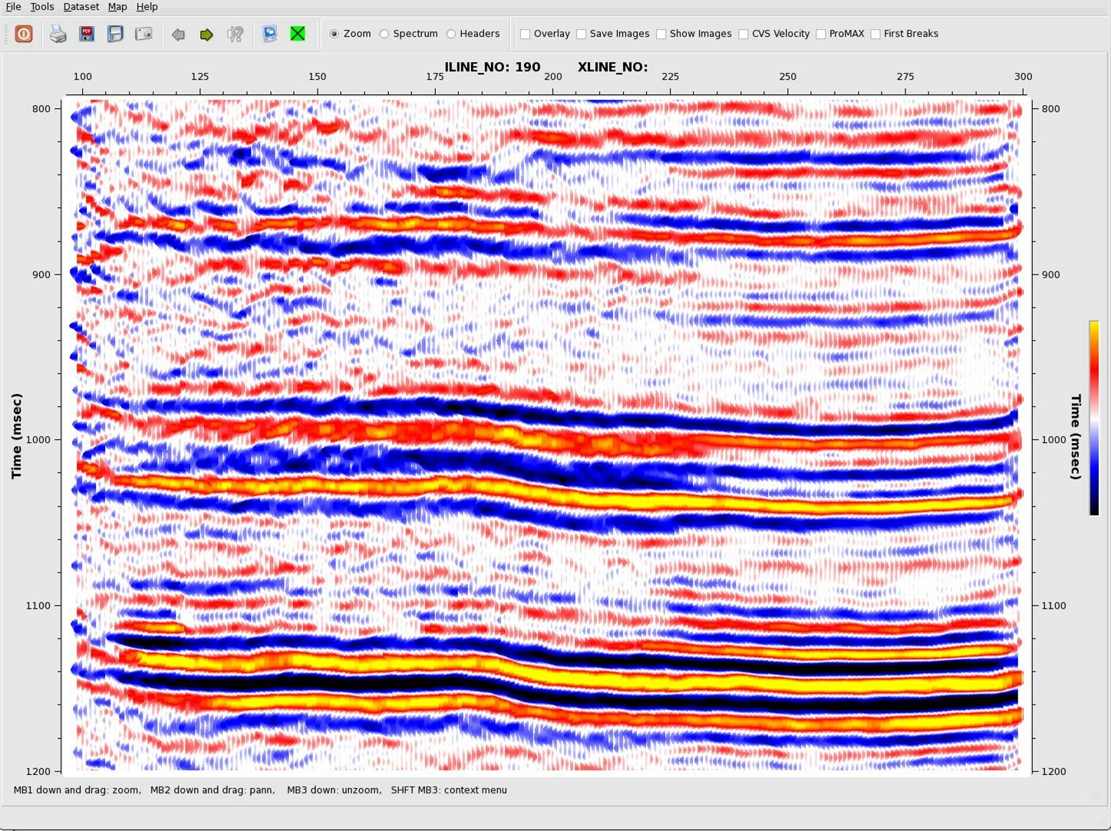
Normal Stack - Marcellus Shale

Slide 4
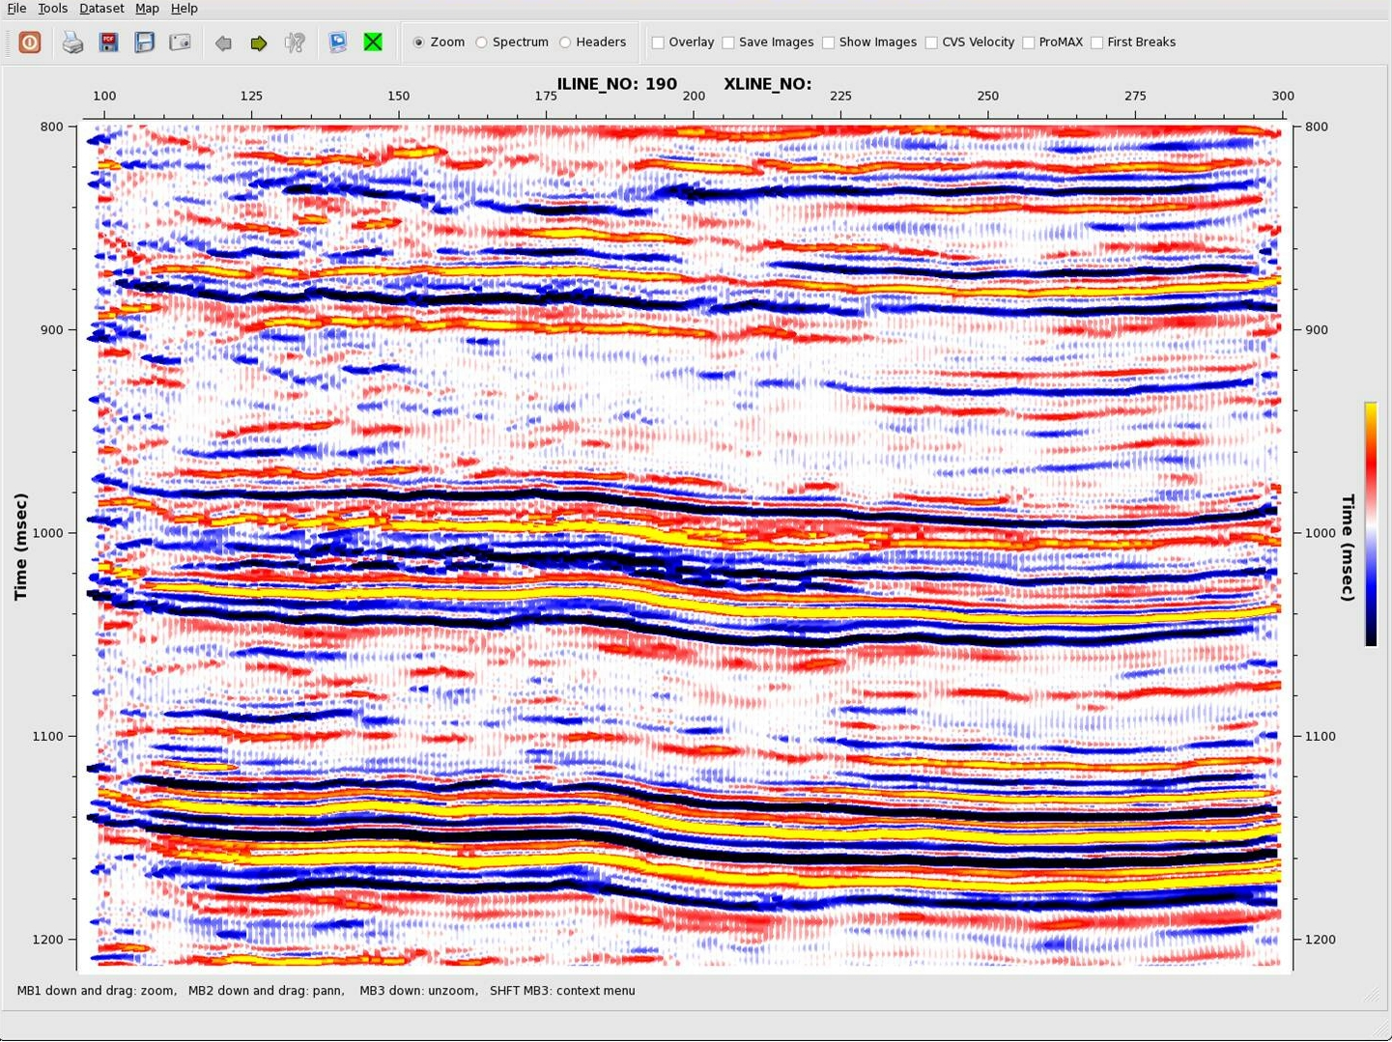
HiRes Stack - Marcellus Shale

Slide 5
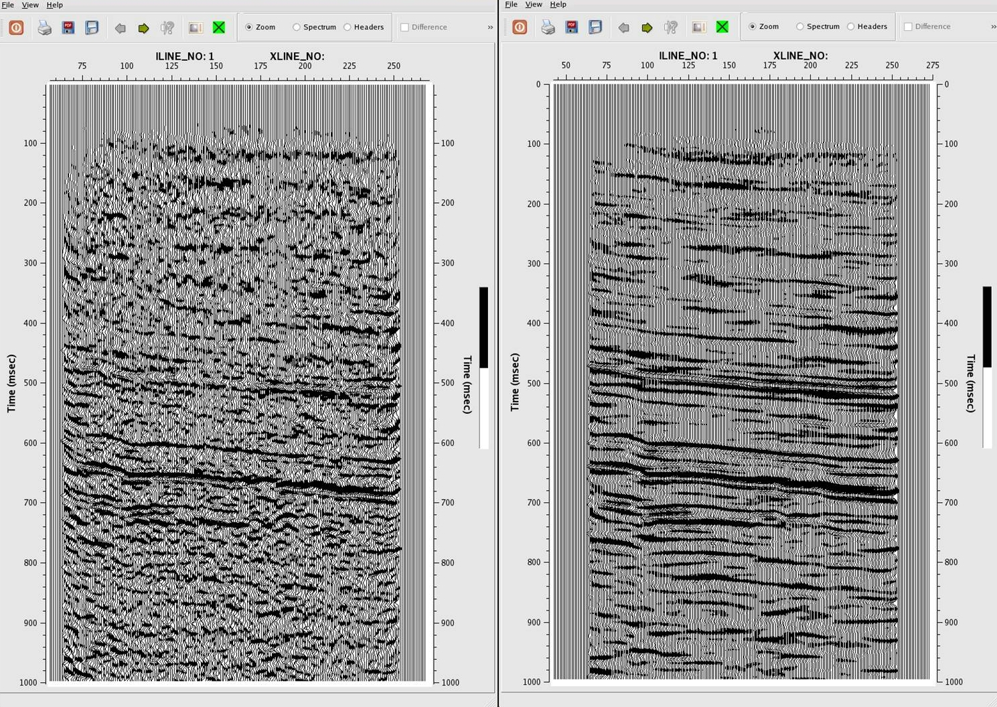
3D Wavenumber Noise Reduction

Slide 6
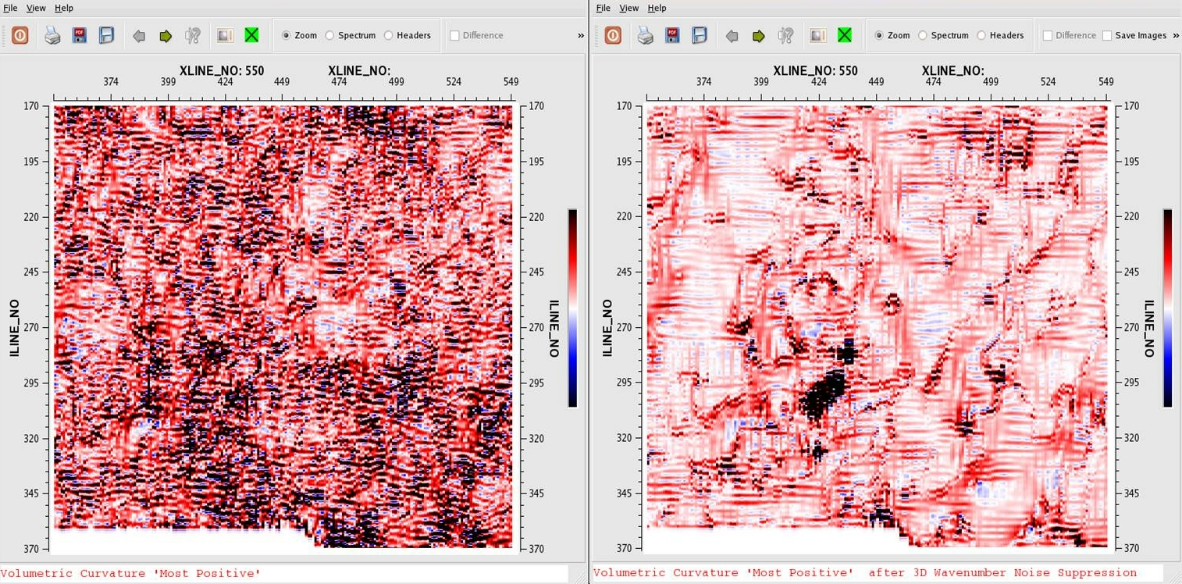
3D Wavenumber Noise Reduction

Slide 7
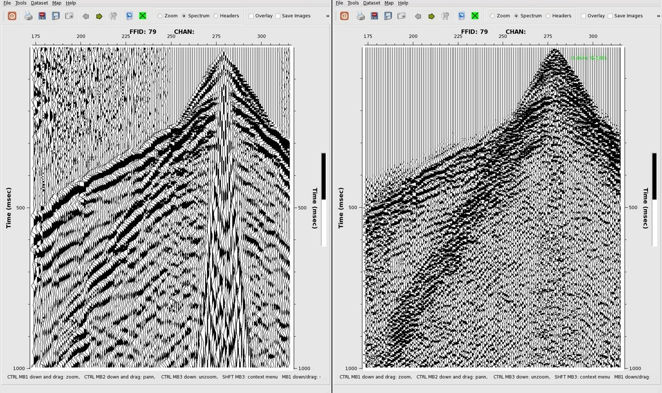
Ring Removal

Slide 8
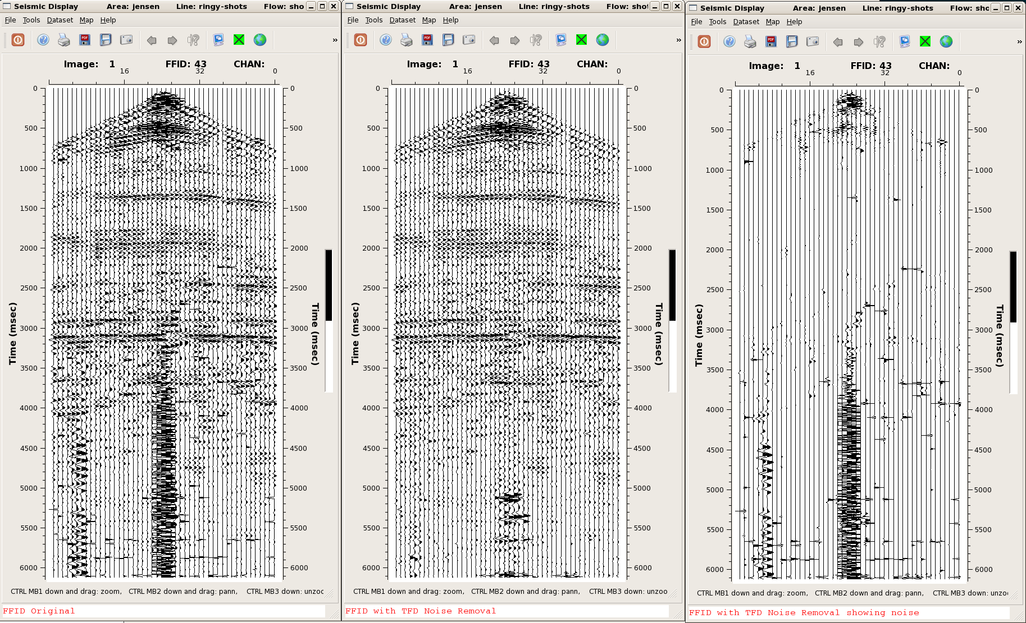
TFD Noise Removal

Slide 9
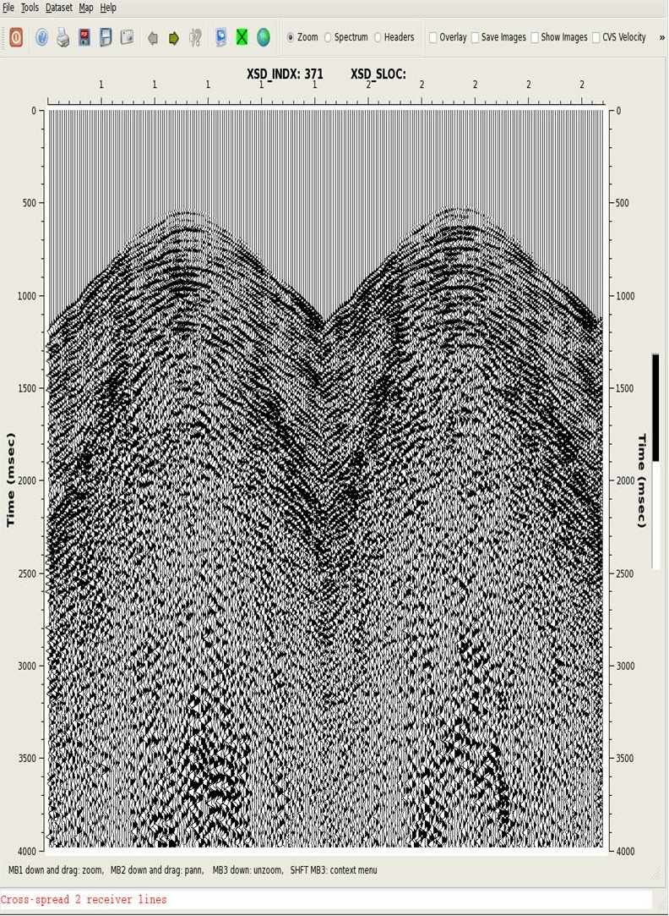
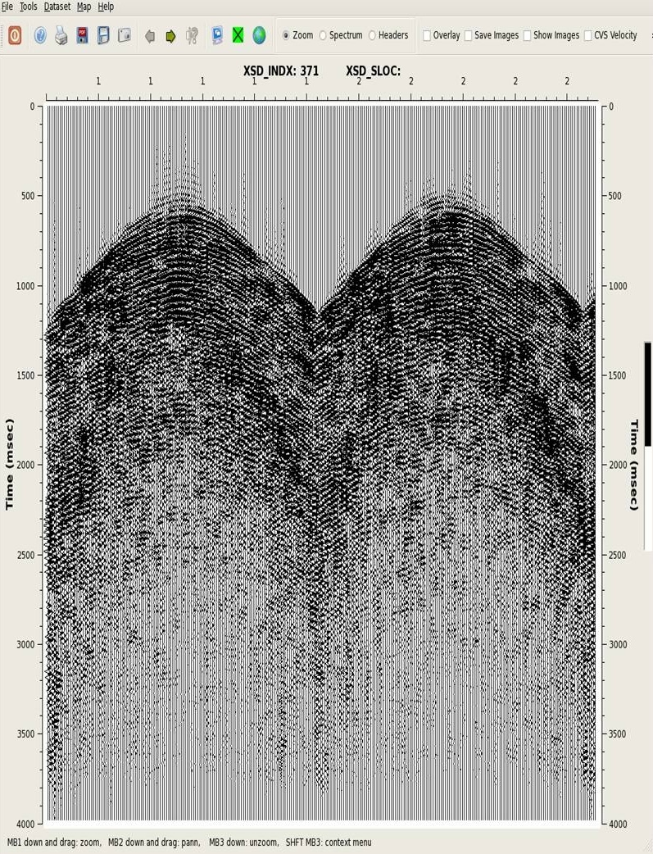
Low Frequency Kx Ky Noise Removal - Crosspreads

Slide 10
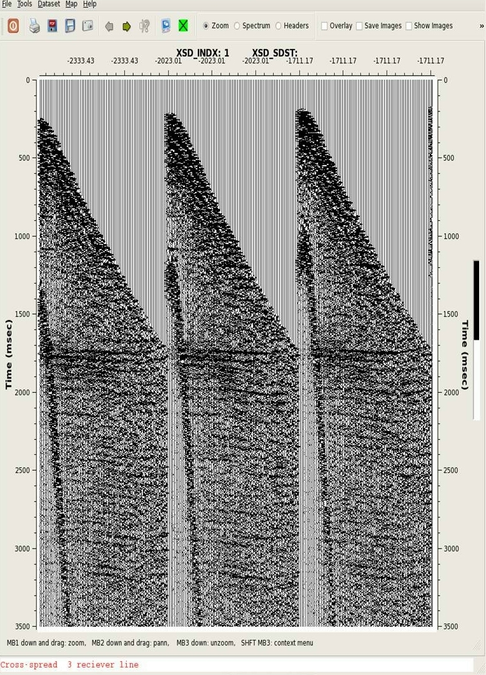
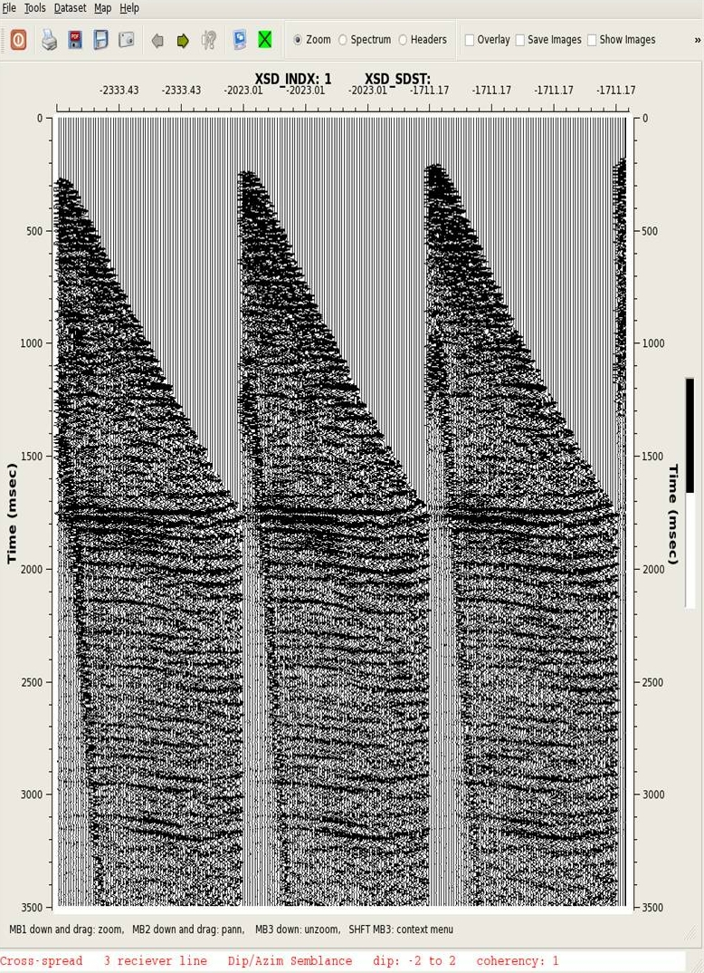
Dip/Azim Semblance - Enhancement - Prestack

Slide 11
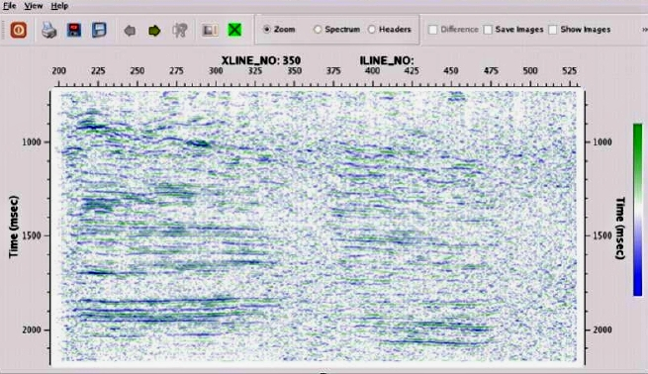
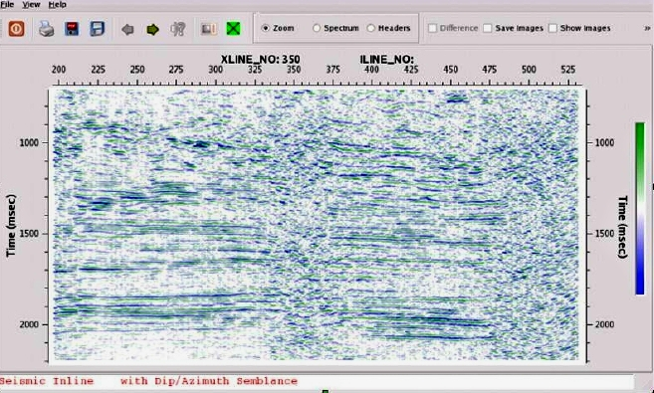
Dip/Azimuth - Enhancement - Poststack

Slide 12
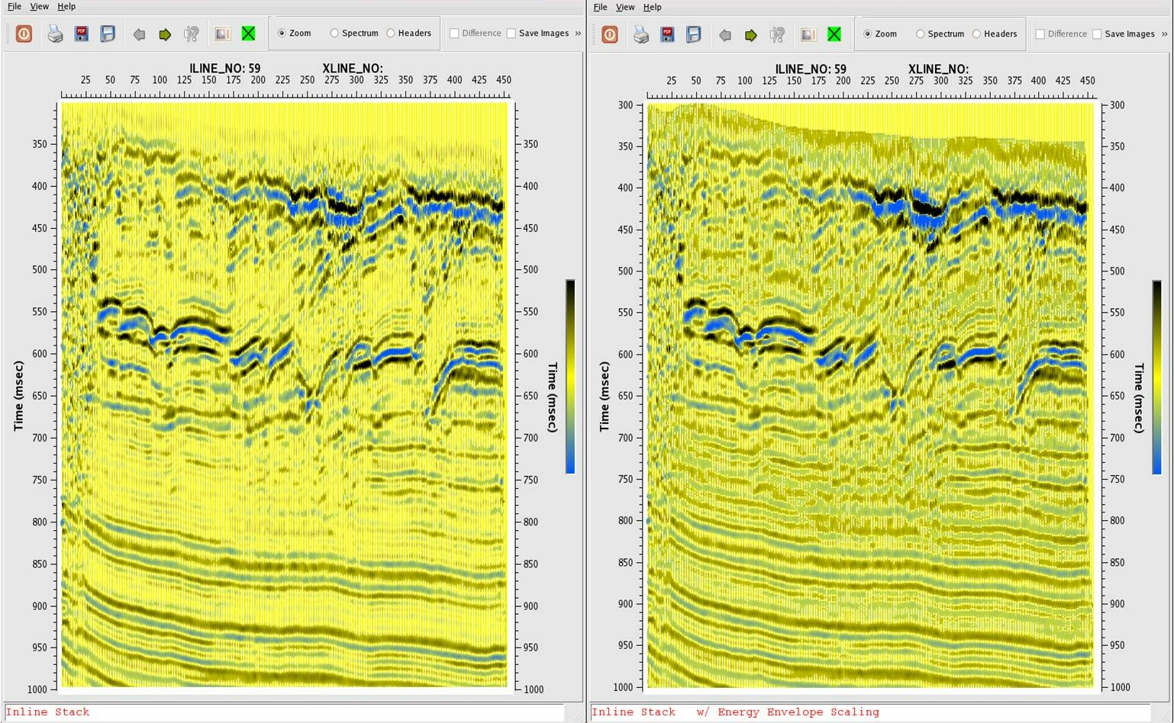
Energy Envelope Scaling

Slide 13
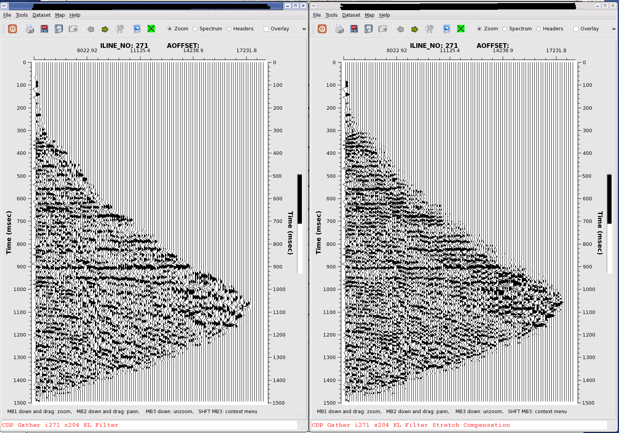
CDP Gather w/ Stretch Compensation

Slide 14
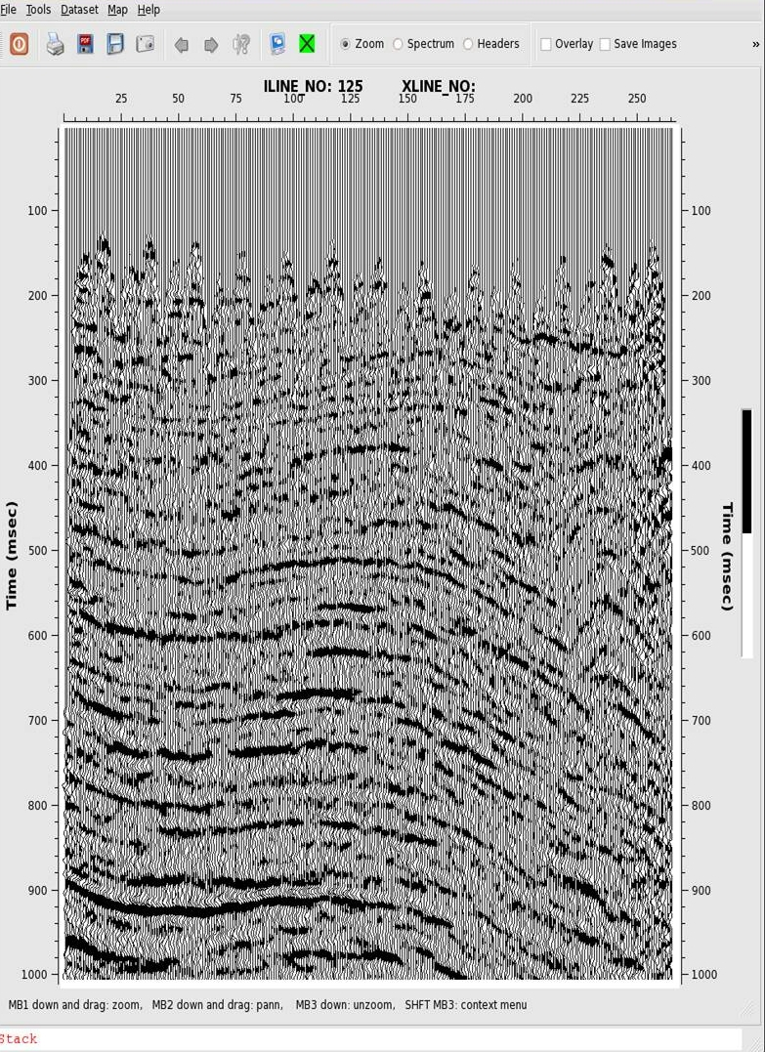
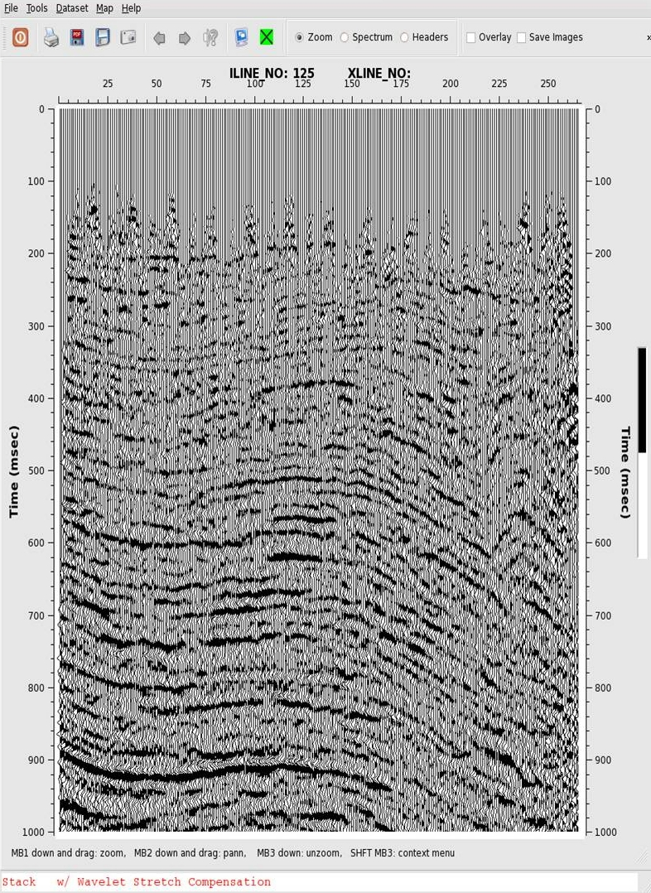
Stack w/ Stretch Compensation

Slide 15
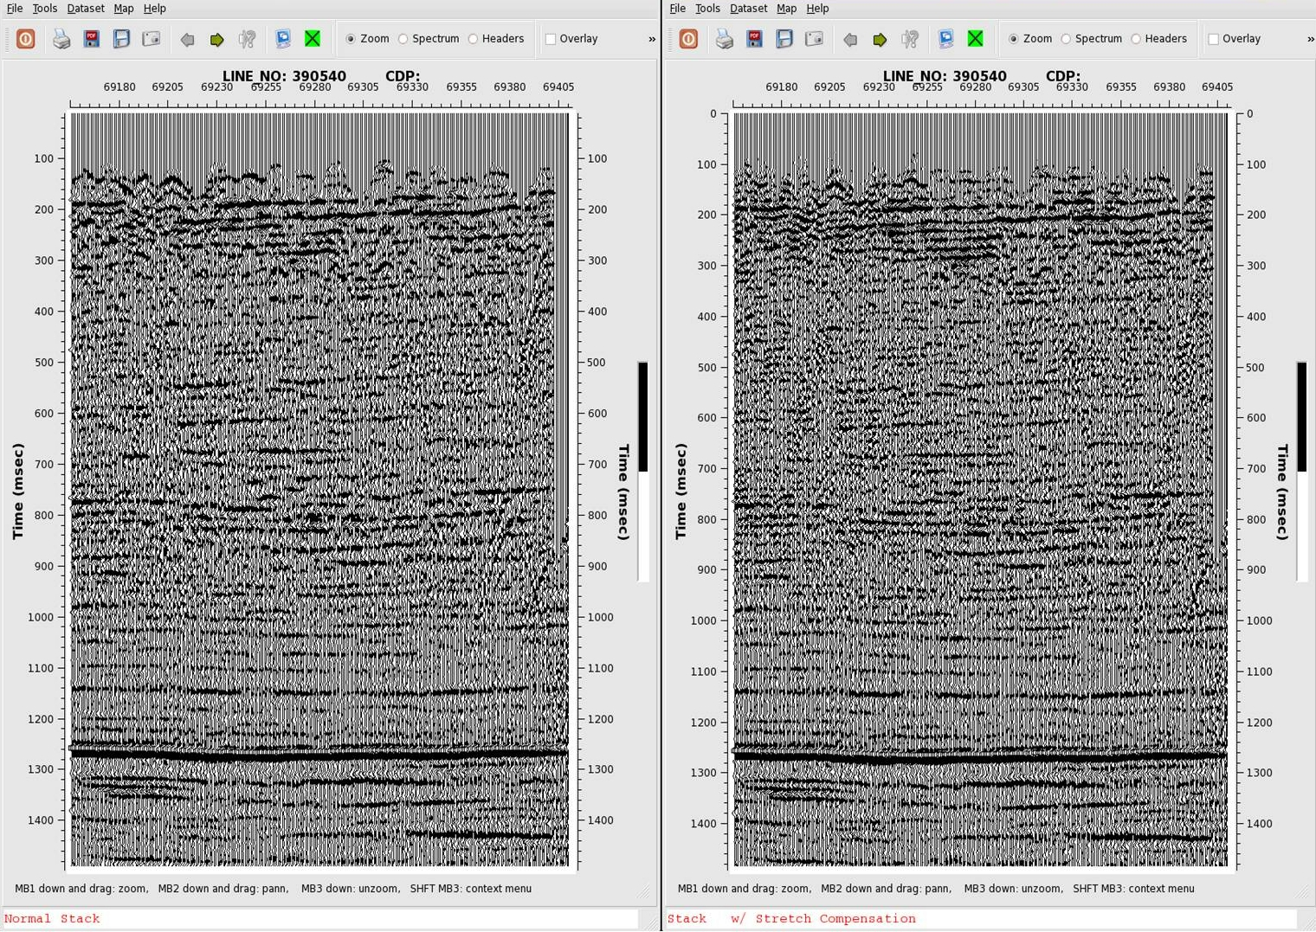
Stack w/ Stretch Compensation

Slide 16
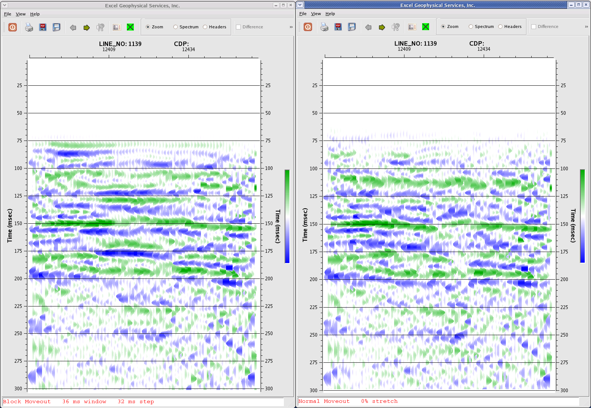
After
Block Moveout
Before

Slide 17
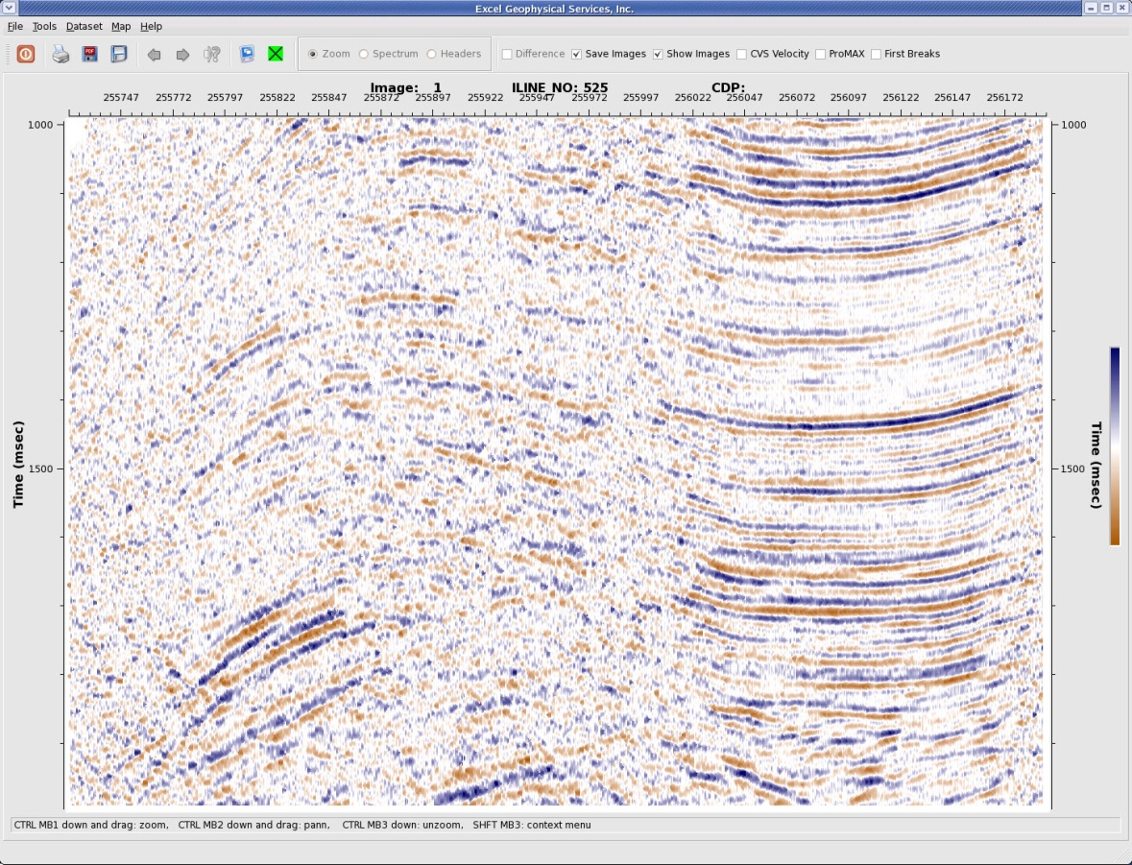
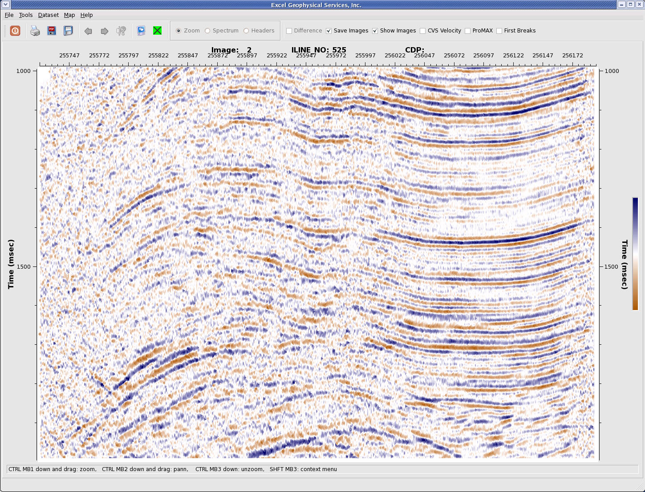
Stack before VELRESA
Stack After VELRESA
Azimuthal Velocity Residual Analysis - VELRESA

Slide 18
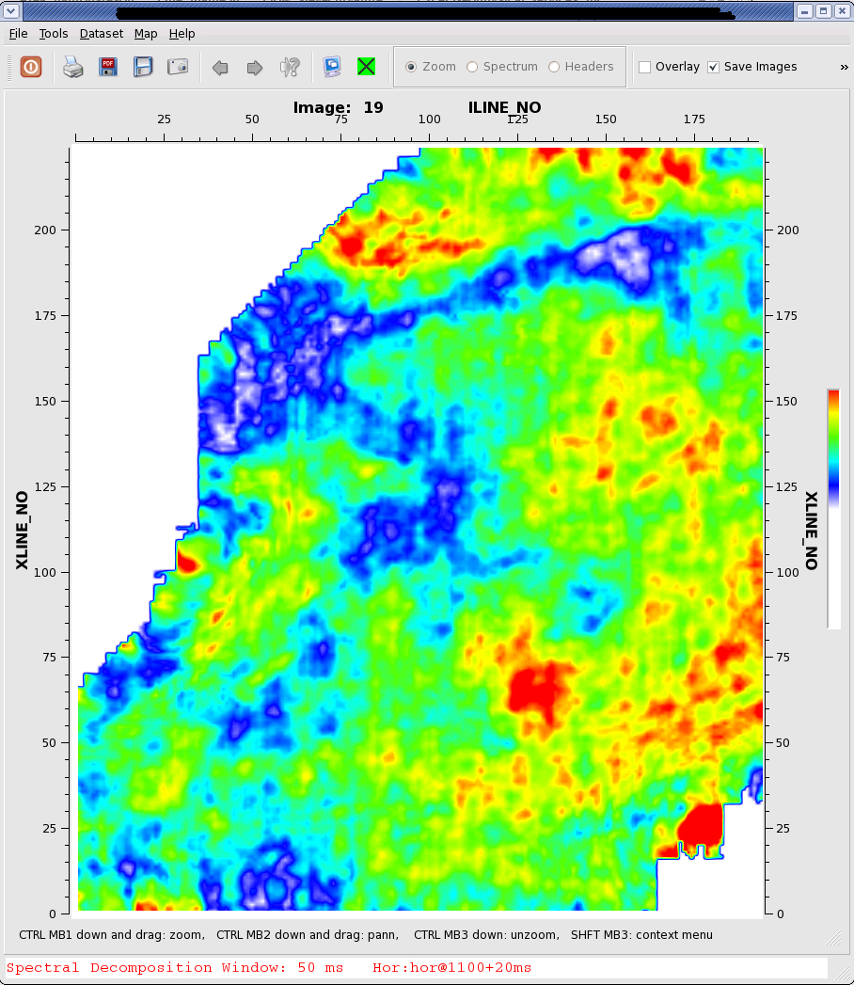
Spectral Decomposition

Slide 19
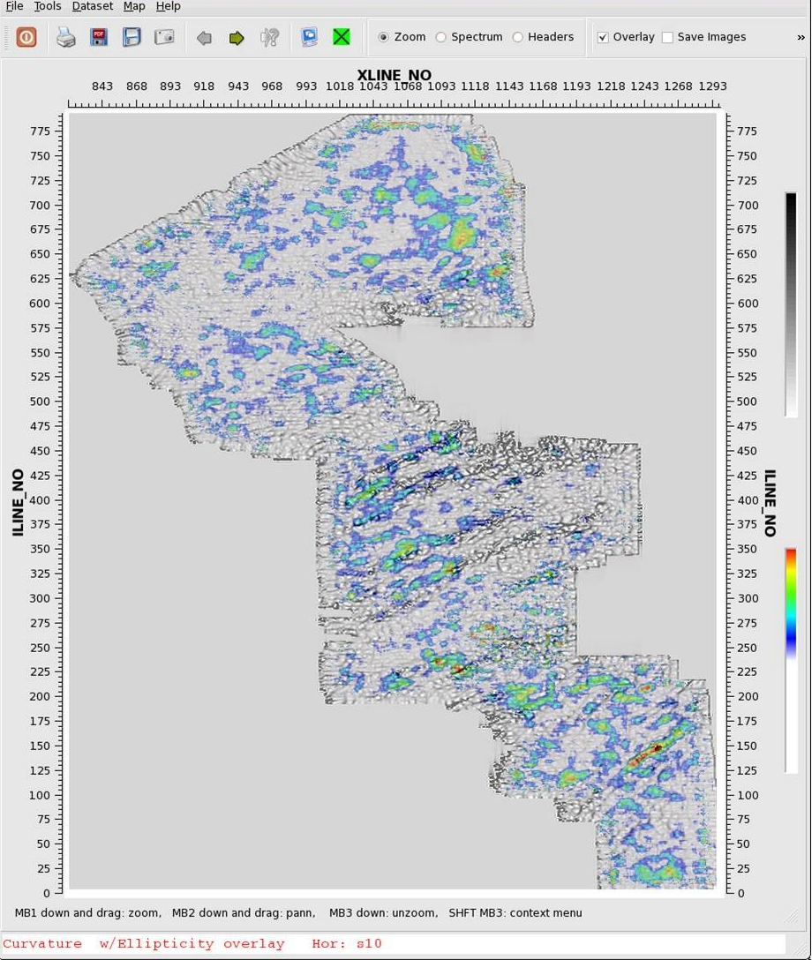
Volumetric Curvature w/ Ellipticity overlay

Slide 20
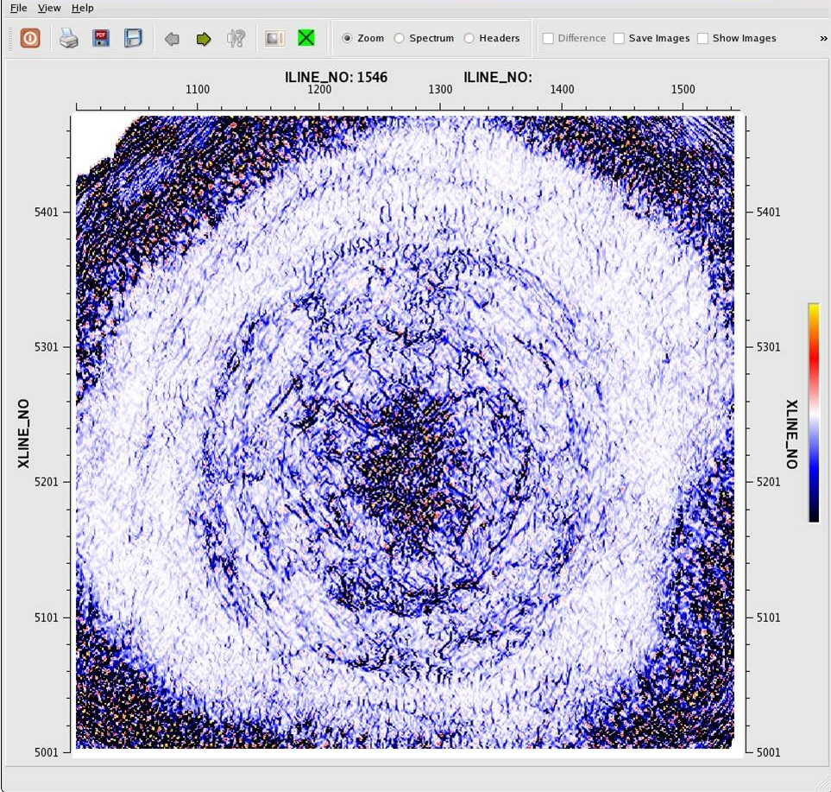
Volumetric Curvature 'Most Positive' exp: 0.1

Slide 21
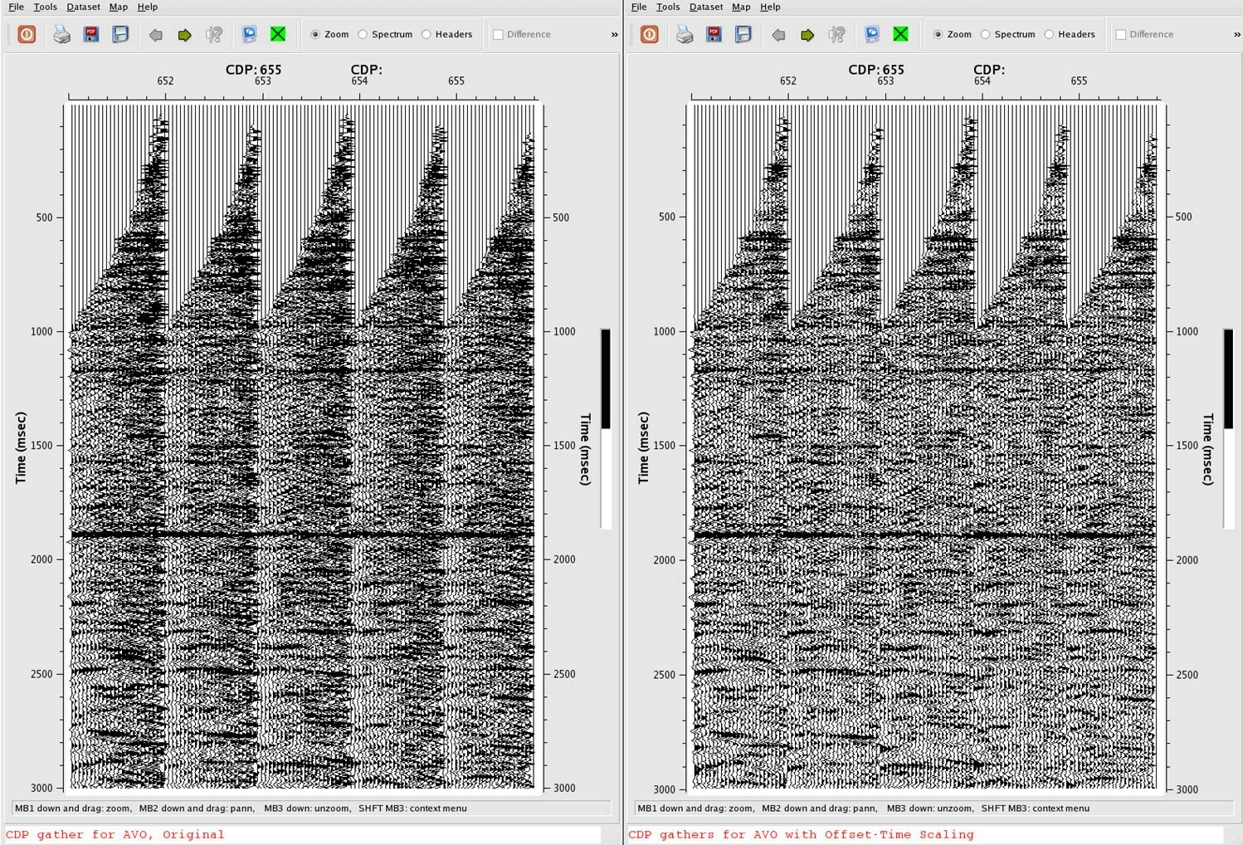
Offset Time Scaling

Slide 22
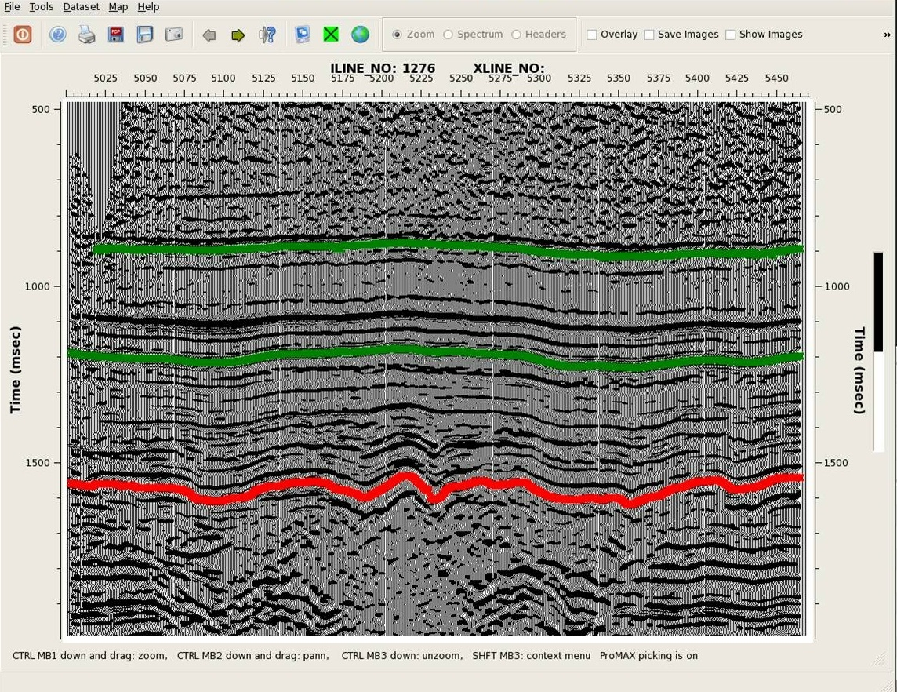
ProMAX Horizon Picking

Slide 23
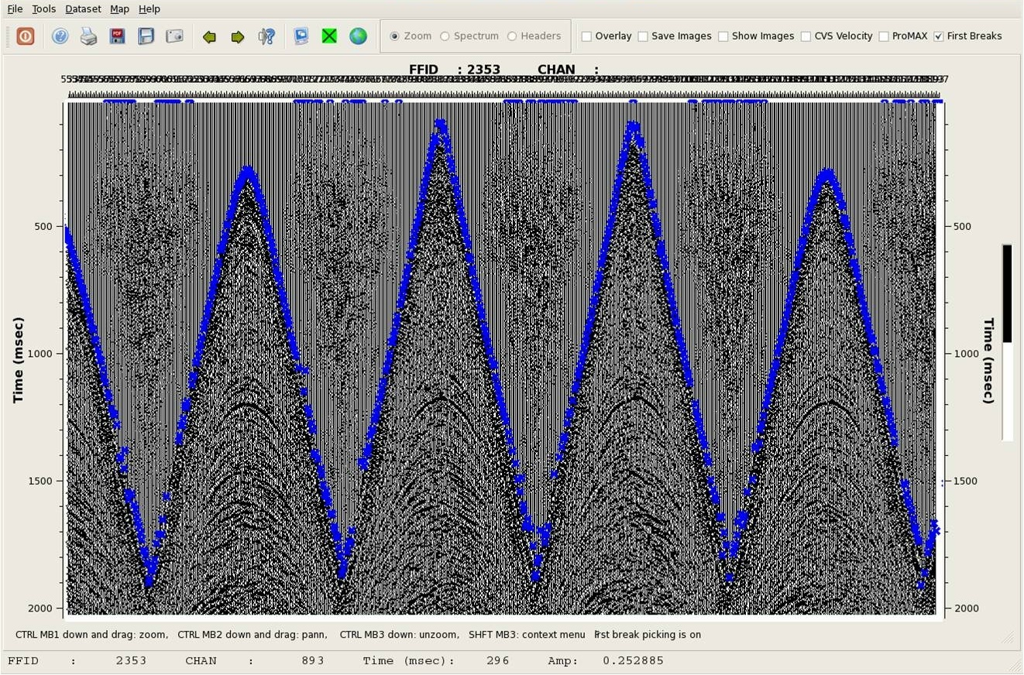
First Break Picking

Slide 24
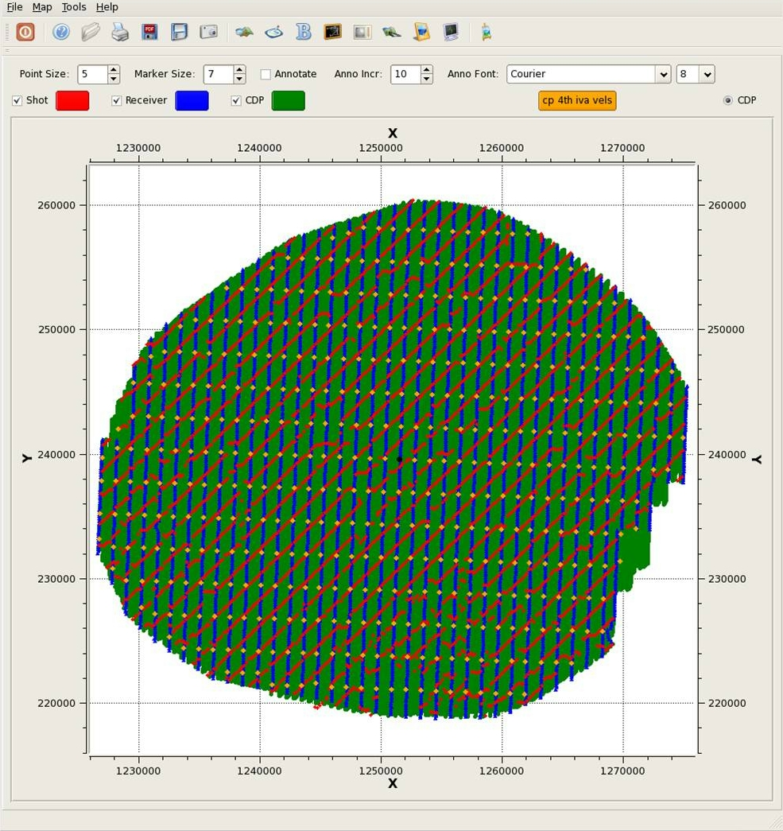
Mapper during Velocity Analysis

Slide 25
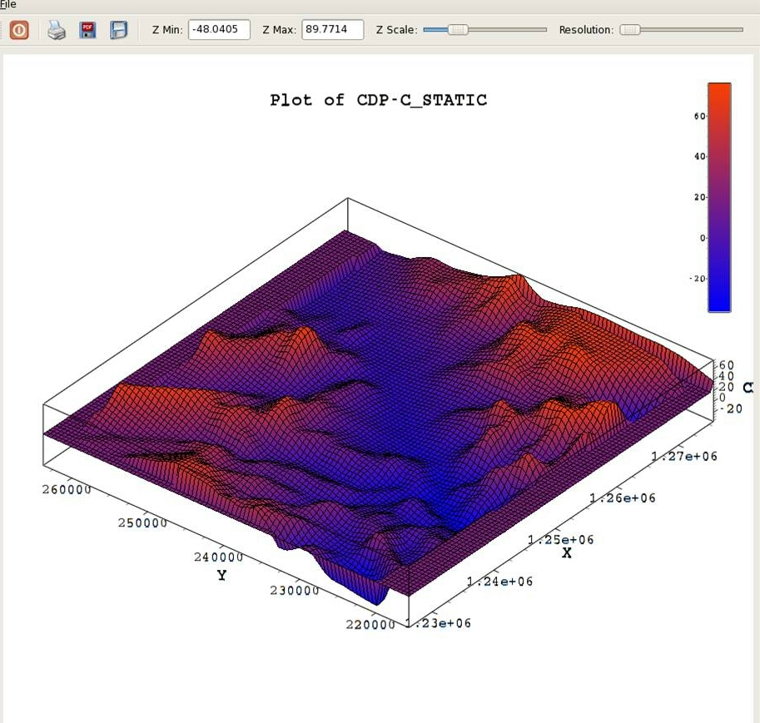
Mapper 3D Attribute Plot

Slide 26
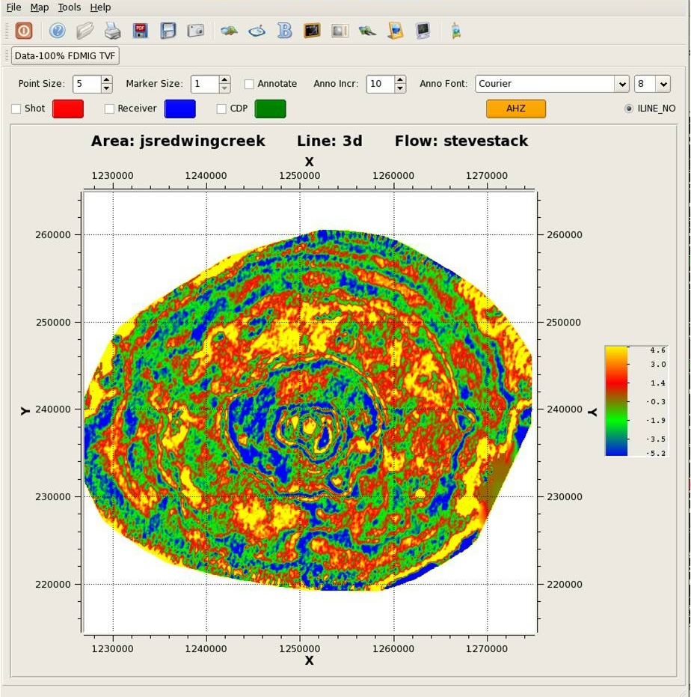
Mapper Attribute Draw

Slide 27
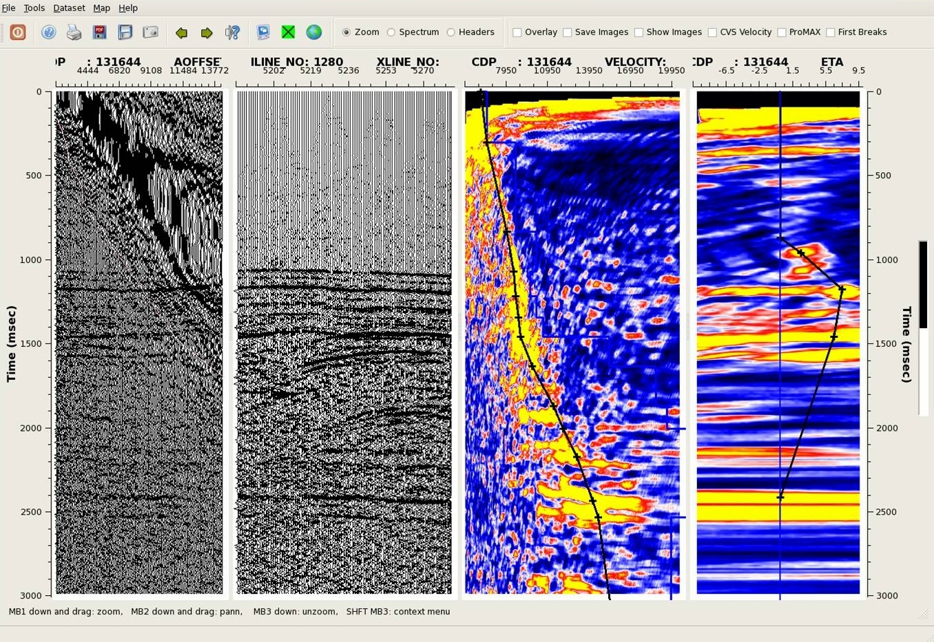
Semblance Velocity Analysis with ETA

Slide 28
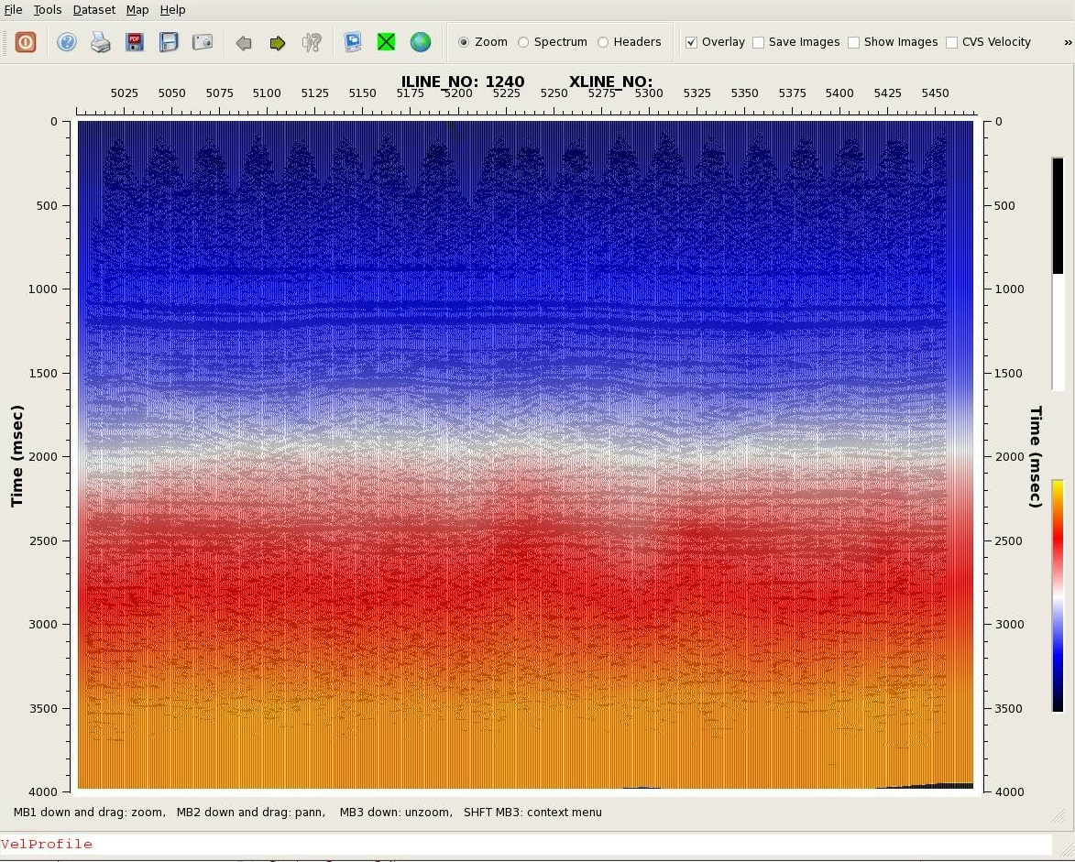
Velocity Profile

Slide 29
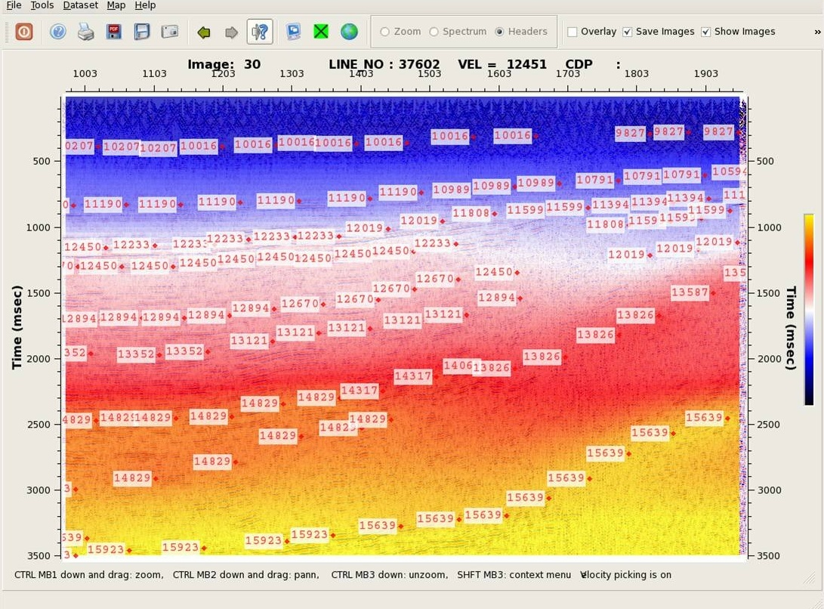
CVS Velocity Analysis

Slide 30
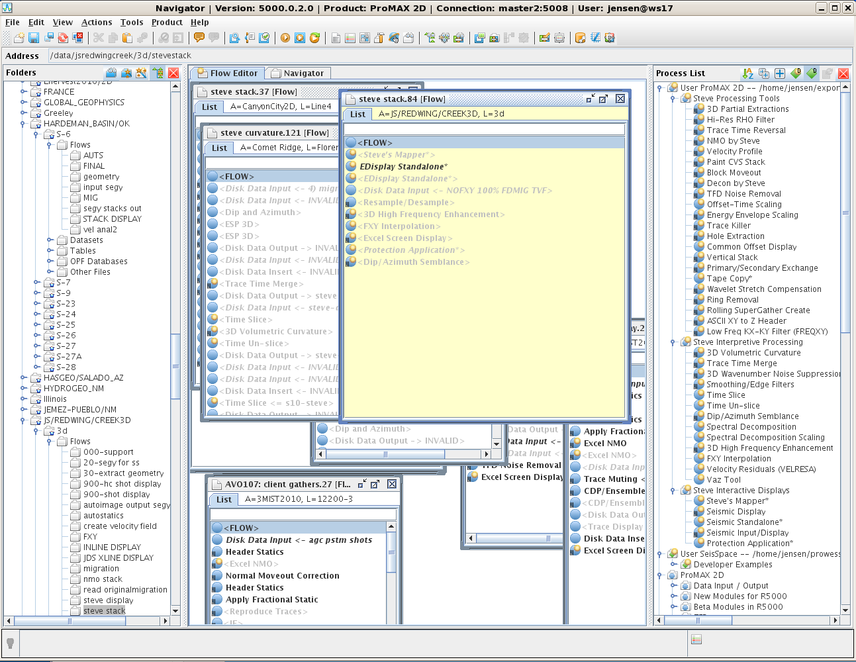

Slide 31
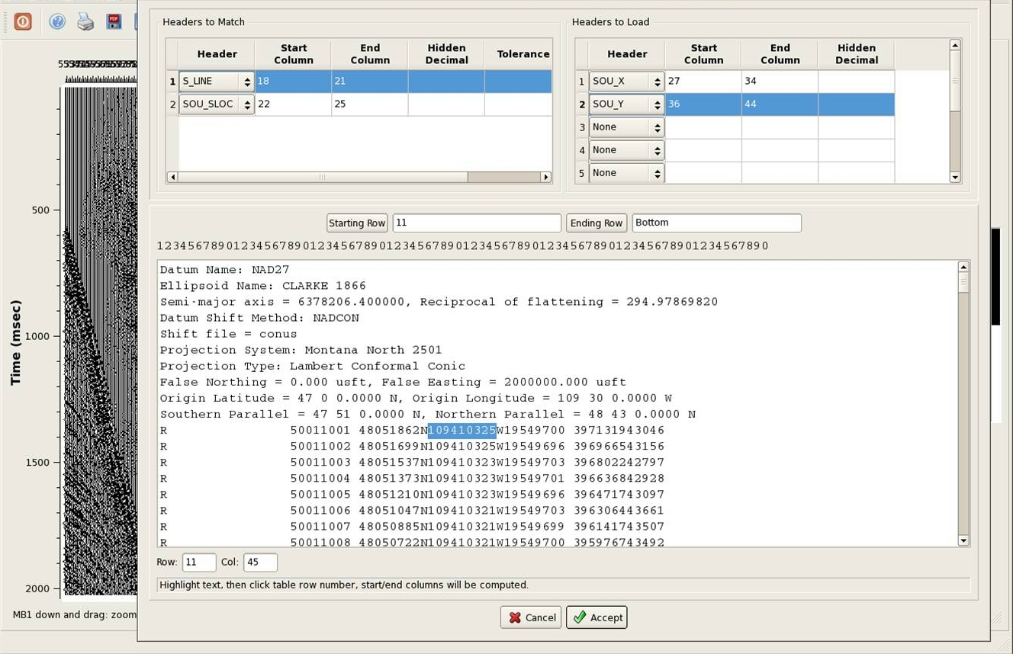
ASCII Geometry Loading

Slide 32
Velocity Analysis - Azimuthal Velocity Residual Analysis (Velresa) - VAZ Tool - CVS Velocity Analysis (found in Seismic Display) - Semblance Velocity Analysis w/Interactive - ETA Velocity Analysis - Normal Moveout - Block Move-Out (Blockem) - Paint CVS Stack - Wavelet Stretch Compensation (Stretcomp) - Velocity Profile

Slide 33
Frequency Enhancement - 3D High Frequency Enhancement (Homer) - Hi Res RHO Filter (RHO)

Slide 34
Seismic Attributes - 3D Volumetric Curvature (Curvy) - Azimuthal Velocity Residual Analysis (Velresa) - VAZ Tool - Spectral Decomposition - Spectral Decomposition Scaling

Slide 35
Noise Reduction - 3D Wavenumber Noise Suppression (Wavy) - Dip/Azimuth Semblance and Enhancement Filter (Dazzle) - TFD Noise Removal (TFDNoise). - Low Frequency Kx-Ky Filter (Freqxy) - Multi-Channel Adaptive Subtraction (Subtract) - Ring Removal (Ringy) - Smoothing/Edge Filters - FXY Interpolation

Slide 36
Other Processing Tools - Spectral Shaping Deconvolution - Energy Envelope Scaling - Offset – Time Scaling

Slide 37
Productivity Tools - 3D Partial Extractions (Extract) - Time Slice/Un-Slice - Trace Killer - Hole Extraction - Common Offset Display - Vertical Stack

Slide 38
Productivity Tools cont’ - Primary/Secondary Exchange - Rolling Supergather Create - Tape Copy - ASCII XY to Z Header - Trace Time Merge

Slide 39
Data Analysis Tools Seismic Display CVS Velocity Analysis Semblance Velocity Analysis w/Interactive ETA Velocity Analysis Spectral Analysis Trace Header Viewing SeisSpace Horizon, Gate and Mute First Break Picking ProMAX Tables

Slide 40
Data Analysis Tools cont’ Seismic Display Geometry Building Phase and Bandpass Filter AGC Tests Time Slices Geometry loading, viewing and editing Linear and normal moveout Image storage and more…

Slide 41
Data Analysis Tools cont’ - Mapper - Seismic Standalone - Seismic Input Display See details on all of the above at: www.crestoneseismic.com

